Slide 1

Monday?

Slide 2
Feedback
Thank you for taking the survey
Lecture slides and notes
Textbook materials and quizzes
Confidence
Notes:
Thank you for taking the survey. It really helps
So I noticed the overarching theme is that
I talk through slides too fast, which some of you can’t catch up or take notes. And some slides I even just brush through it. So I just want to remind you that it’s fine if you want to take notes, but all of my slides will be available along with my notes after class. Hence, technically, you don’t have to take notes. And I will go over how you can obtain the slides again. Moreover, some slides that I do not think are important, then I will just brush through them, and obviously you can review them if you wish
A second theme is that you want me to cover more textbook materials and things that will be tested in quizzes. However, as I mentioned in the first class, I don’t want to repeat what you’ve already read in the textbook. I want to show you above and beyond the textbook or its application. If you don’t understand any concepts from textbook, please feel free to ask me. But I will only go over those that I think you will find more difficult to understand. Furthermore, regarding the quizzes, they are materials from both the textbook and lectures. Plus, it’s open book and open note. Hence, as long as you review the slides and have your book with you, then you should be fine. Moreover, I always see that almost all of you score 9 or 10 already. I believe this shouldn’t be a problem
Lastly, another theme is that a lot of you suggested me to be more confident. In my defense, I was just trying to get instant feedback. I just don’t know if I explain myself clear, should I explain something again or should I move onto the next topic. Hence, that’s why I want your help in letting me know that you understand the lecture and we can move on. Maybe giving a nod would suffice

Slide 3

iClicker Question
Constructs exist in the real world, and you can measure and quantify them. While variables exist in the conceptual/theoretical domain, and you can't measure them.
TRUE
FALSE

Slide 4
Construct and Variables
Construct is “an abstract idea or concept composed of a set of attitudes or behaviors that are thought be related.”
Conceptual/Theoretical Domain
Construct A
Construct B
Variables are ”elements of a construct that can be measured or quantified”
Variable X
Variable Y
Real world
Notes:
I hope you guys did read or at least skim this chapter. Because what I am going to talk about is PhD-level knowledge.
In social science, when we want to formulate a theory, we only do it in the conceptual world that contain constructs.
Construct is “an abstract idea or concept composed of a set of attitudes or behaviors that are thought be related.”
Variables are ”elements of a construct that can be measured or quantified”
They are called variables because they can take on different values, that is, they can vary
I know this still seems rather vague; we will go into an example in the next slide
If you can understand the difference between constructs and variables, you already finish a quarter of your phd.

Slide 5

iClicker Question
Difference analysis requires your grouping variable to be continuous.
TRUE
FALSE

Slide 6
Another representation
Categorical/
Discrete
Difference
Analysis
X
Y
Continuous
X
Y
Association
Analysis

Slide 7
Recap Last Class
Reminder: Evidence of Causality
Constructs vs. Variables
Analyses:
Descriptive
Difference
Association

Slide 8




Collecting Descriptive Primary Data
Notes:
Chapter 9

Slide 9

Chapter 9: Collecting Descriptive Primary Data – Learning Objectives
Cite three major purposes of descriptive research
List the six specifications of a descriptive study
Discuss the difference between cross-sectional and longitudinal designs
Explain what is meant by a panel in marketing research, and explain the difference between a continuous
Describe the emphasis in sample surveys
List the kinds of demographic and socioeconomic characteristics that interest marketers
Cite the three main approaches used to measure awareness

Slide 10
Three Purposes of Descriptive Research
Describe the characteristics of certain groups
Estimate the proportion of people who behave in a certain a certain way
Make specific predictions
Exploratory research is very flexible; descriptive research is MUCH more rigid
Descriptive research requires the clear specification of WHO, WHAT, WHEN, WHERE, WHY, HOW before data collection can begin

Slide 11
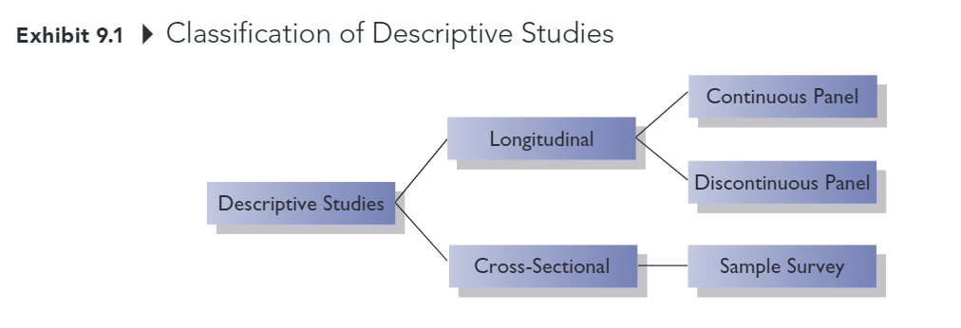
Classification of Descriptive Studies

Slide 12
Classification of Descriptive Studies
Longitudinal study: Investigation involving a fixed sample of elements that is measured repeatedly through time
Continuous panel: A fixed sample of respondents who are measured repeatedly over time with respect to the same variables
Discontinuous panel: A fixed sample of respondents who are measured repeatedly over time but on variables that change from measurement to measurement
Cross-sectional study: Investigation involving a sample of elements selected form the population of interest that are measured at a single point in time
Sample Survey: Cross-sectional study in which the sample is selected to be representative of the target population and in which the emphasis is on the generation of summary statistics such as averages and percentages

Slide 13
Types of Primary Data
Demographic/socioeconomic characteristics
Personality/lifestyle characteristics
Attitudes
Awareness/knowledge
Intentions
Motivation
Behavior

Slide 14
Demographic/Socioeconomic Characteristics
Often used to divide a population into groups (e.g., for market segmentation purposes)
Some commonly measured variables:
Age
Income
Occupation
Education
Gender
Ethnicity

Slide 15
Personality/Lifestyle Characteristics
Personality: normal patterns of behavior exhibited by an individual; the attributes, traits, and mannerisms that distinguish one individual from another
Lifestyle: How individuals live, what interests them, their values, and what they like

Slide 16
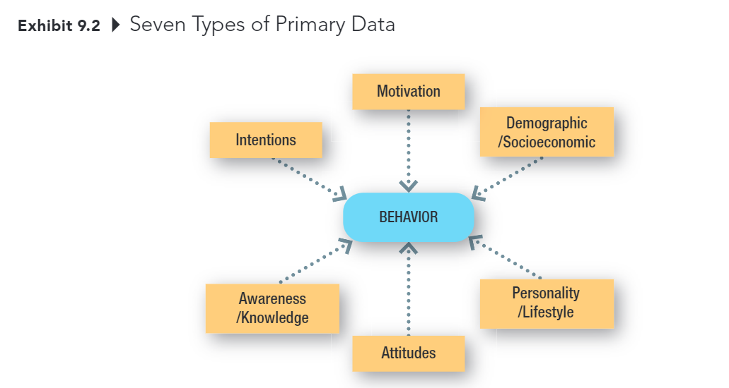
Types of Primary Data

Slide 17
Attitudes
An attitude is an individual's overall evaluation of something
Marketers often measure people’s attitudes toward companies, products, and services. They also measure may “attitude-like” variables including value, quality, and satisfaction.

Slide 18
Awareness/ Knowledge
Insight into, or understanding of facts about, some object or phenomenon.
Marketers often want to know what individuals know or believe about products, brands, companies, advertisements, and so on.

Slide 19
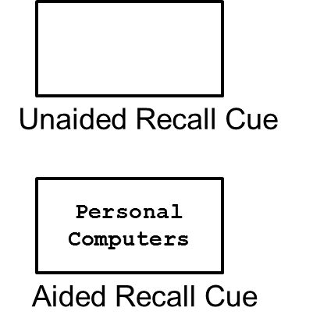
Measuring Awareness
Unaided Recall: For what products and brands do you remember seeing ads?
Aided Recall: Do you remember seeing ads for personal computers?

Slide 20
Intentions
Anticipated or planned future behavior
Marketers often need this type of information to assess demand for a product or service
Estimating demand for products and services accurately is one of the most difficult tasks a marketing researcher faces
Notes:
Definitely would buy
Probably would buy
Undecided
Probably would not buy
Definitely would not buy

Slide 21
Motivation
A need, a want, a drive, a wish, a desire, an impulse, or any inner state that energizes, activates, moves, directs, or channels behavior toward goals
If we understand what drives consumer behavior, we are in better position to anticipate consumer needs and offer products and services that satisfy those needs.

Slide 22
Behavior
What subjects have done or are doing
Behavioral data might be obtained by observing behaviors or by asking consumers to remember and report their past behaviors.

Slide 23
Chapter 10: Collecting Data by Observation – Learning Objectives
Describe the two basic means of obtaining primary data
State the specific advantages of each method of data collection
List the important considerations in the use of observational methods of data collection
Explain the difference between structured and unstructured observation.
Cite the main reason researchers may choose to disguise the presence of an observer in a study
Explain the advantages and disadvantages of conducting an observational experiment in a laboratory.
List several approaches to mechanical observation

Slide 24
Two Methods of Data Collection
Communication
A method of data collection involving questioning respondents to secure the desired information using a data collection instrument called a questionnaire.
Observation
A method of data collection in which the situation of interest is watched and the relevant facts, actions, or behaviors are recorded

Slide 25
Communication vs. Observation
Attribute | Communication | Observation
Versatility | 4
Speed | 4
Cost | 4
Objectivity |  | 4
Accuracy |  | 4

Slide 26
Why use observation research?
Observation is often the best method for generating valid data about individual’s behavior.
E.g., using communication methods we can ask a consumer to estimate how many jars of peanut butter he purchased at a particular store in the past year. With observation research, we can KNOW how many jars he purchased at that store in the past year.

Slide 27
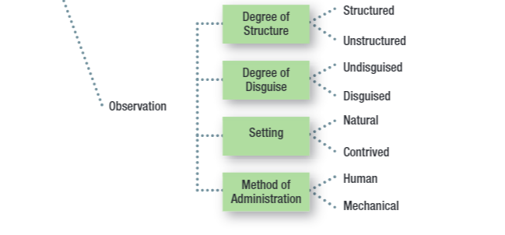
Key Issues for Collecting Information by Observation

Slide 28
Structured Observation
Structure: The degree of standardization used with the data collection instrument.
Method of observation in which the phenomena to be observed (typically behaviors) can be defined precisely along with the categories used to record the phenomena.

Slide 29
Unstructured Observation
Method of observation in which the researcher has a great deal of flexibility in terms of what to note and record.

Slide 30
Disguise
The amount of knowledge people have about a study in which they are participating

Slide 31
Disguised vs Undisguised Observation
With disguised observation, subjects are not aware that they are being observed
Ethical considerations -> Debriefing
With undisguised observation, subjects are aware that they are being observed

Slide 32
Natural Setting
Subjects are observed in the environment where the behavior normally takes place
Shopping in a store
Using or consuming a product at home

Slide 33
Contrived Setting
Subjects are observed in an environment that has been specially designed for recording their behavior
Fake store
Computer simulation

Slide 34
Human vs. Mechanical Observation
With human observation, individuals are trained to systematically observe a phenomenon and to record the observational form the specific events that take place
With electrical or mechanical observation, an electrical or mechanical device observes a phenomenon and records the events that take place.
E.g., Video cameras, bar code scanners, response latency, Galvanometer, voice-pitch analysis, eye camera.

Slide 35
Chapter 11: Collecting Data by Communication
Explain the concept of structure as it relates to questionnaires
Cite the drawbacks of using high degrees of structure
Explain what is meant by disguise in a questionnaire
Discuss two situations in which disguise might be desirable
Differentiate among the main methods of administering questionnaires
Discuss three important aspects used to compare the four different methods of administering questionnaires.

Slide 36
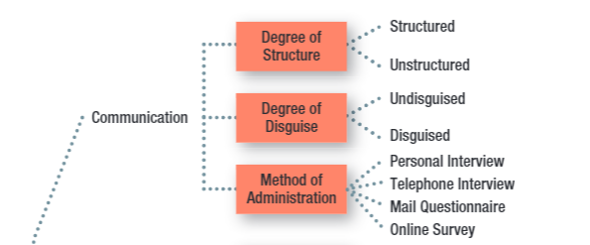
Key Issues for Collecting Information by Communication

Slide 37
Key Issues for Collecting Information by Communication
Fixed-Alternative Questions: Questions in which the responses are limited to stated alternatives
Open-ended question: a question in which respondents are free to reply in their own words rather than being limited to choosing from among a set of alternatives.
Notes:
Structure: the degree of standardization used with the data collection instrument

Slide 38
High Structure: Advantages and Disadvantages
Attribute | Disadvantage | Advantage
Ease of Administration |  | 4
Ease of Coding and Analysis |  | 4
Measure Reliability |  | 4
Response Bias:
Forced choice | 4
Omitted response | 4
Precision of response | 4

Slide 39
The Ethics of Disguise
Disguise: the amount of knowledge people have about a study in which they are participating
Under the rights model of ethics, the use of disguise amounts to a violation of the respondent’s right to know
Debriefing: The process of providing appropriate information to respondents after data have been collected using disguise
Notes:
Disguise is especially use when
Knowing the purpose or sponsor is likely to bias respondent’s’ answers
Re-creating the natural environment is necessary, particularly in experimental research

Slide 40
Primary Methods of Administration
Personal Interviews
Telephone Interviews
Mail Surveys
Online Surveys

Slide 41
Personal Interview
Direct, face-to-face conservation between a representative of the research organization, the interviewer, and a respondent or interviewee
Can be conducted in lots of different locations (including malls using mall intercepts)
Generally strong sampling control (including higher response rates)
Great flexibility, but higher levels of interviewer bias
Time and cost-intensive

Slide 42
Survey Types
Random-digit Dialing (RDD): A technique used in studies using telephone interviews, in which the numbers to be called are randomly generated
In-bound surveys: A method of data collection in which respondents access a survey by telephone or on the Web to respond to survey items.

Slide 43
Mail Survey
A survey administered by mail to designated respondents with an accompanying cover letter. The respondents return the questionnaire by mail to the research organization.
Lower degree of sampling control (mailing lists often available, but no control over who completes survey, and often low response rates)
No interviewer bias and can offer anonymity, but less flexibility (no explanation or follow-up, no complex materials)
Lower cost than personal or telephone interviews.
Notes:
In real world,
Personal interviews 67%
Telephone 61%
Paper-based survey 32% Online survey 97%

Slide 44
Online Survey
A method of administration that relies on the web for completing the survey
Explosion in use over the past decade
Email lists and panels are readily available, but it’s difficult to know how you are really contacting, response rates are often very low
Good flexibility: visuals and complex material possible
Usually quick and inexpensive

Slide 45
Recap

Slide 46
5-min snippet

